Slide 1
SR . Public.sr.sec.School Made By – Aryan Singh Class – X Category – Senior

Slide 2
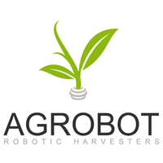

Slide 3
Index :
(1.) Introduction (2.) Solution of Problems (3.) Conclusion (4.) Work Area (5.) Reason to choose the title (6.) Aim (7.) Hypothesis (8.) Data Collection (9.) DataAnalysis (10.) Problemsduring visit (11.) Technicalproblems (12.) Experience (13.) Effect on society (14.) Future plan (15.) Questionnaire

Slide 4
In previous days farmer need animal, tractor etc for land they use different types of machine to perform individual function. It is very difficult that they needed different machines and most important work in Suny Days. My idea to build smart and automatic agriculture robot which can perform different function like sowing of seed , digging the field , rolling on a field to makes soft , harvesting , aur water pumping/Sprinkle, Crop Production, Irrigation, Filling, spraying etc. Which is simple control by a battery . And the battery which we required simple charge by the the Sun . Or are full machine can be control by the Android phone if we want. Big machines are needed to do farming, tractor etc., goods and so on. Not everyone has, then they have to borrow loan. And he slowly and drowned in debt. And sometimes and animals also spoil the crop.

Slide 5
The project «AgroBot» is a system of autopilot agricultural equipment. This solution allows you to automate a significant part of field work, make them faster and more accurate, eliminating the human factor. operates 24/7, which increases the efficiency of the use of agricultural equipment; reduces the costs of farmers and agroholdings for fuel; optimizes the cost of maintaining equipment; increases yields, and also contributes to the development of agricultural land in areas remote from infrastructure and in difficult climatic conditions.

Slide 6
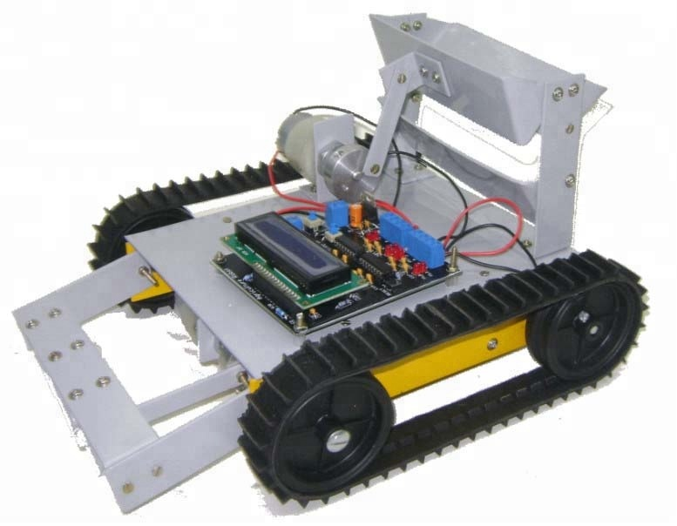

Slide 7
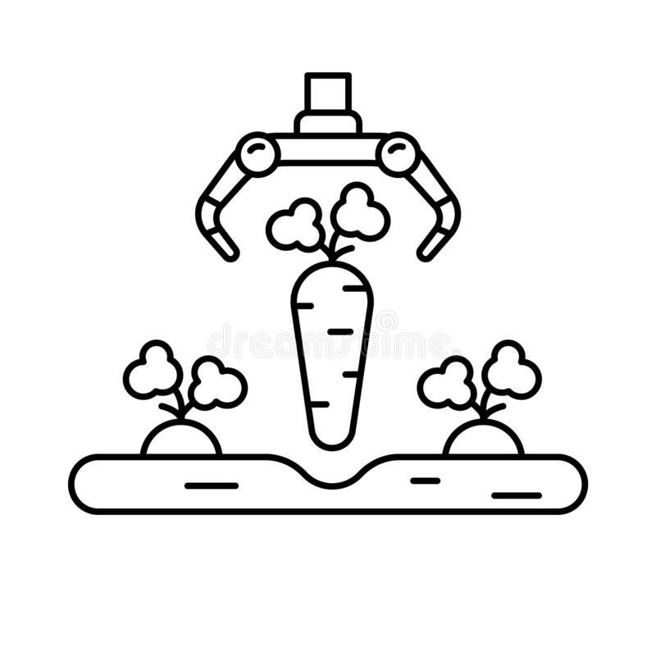
The project is consist of multi functioning robot Which perform functions such as Seeding , Water Spraying , Digging , Cuding heavy objects , And the additional features is Intruder Detection . And My project is consist of 3(three) Parts …
(1.) Robot Part + Remote Part .
(2.) Land Part ( Intruder detection).
(3.) IOT based Smart Irrigation System.
Farmers who buy big machines waste both their time and money and drown in debt. Through my project, they will get money and other help in their work. And those who work in hard sunlight will help a lot through this machine.

Slide 8
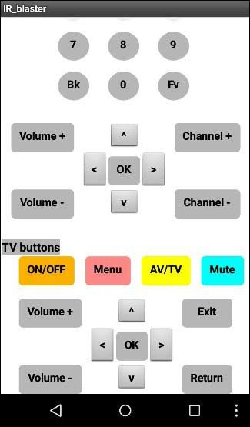
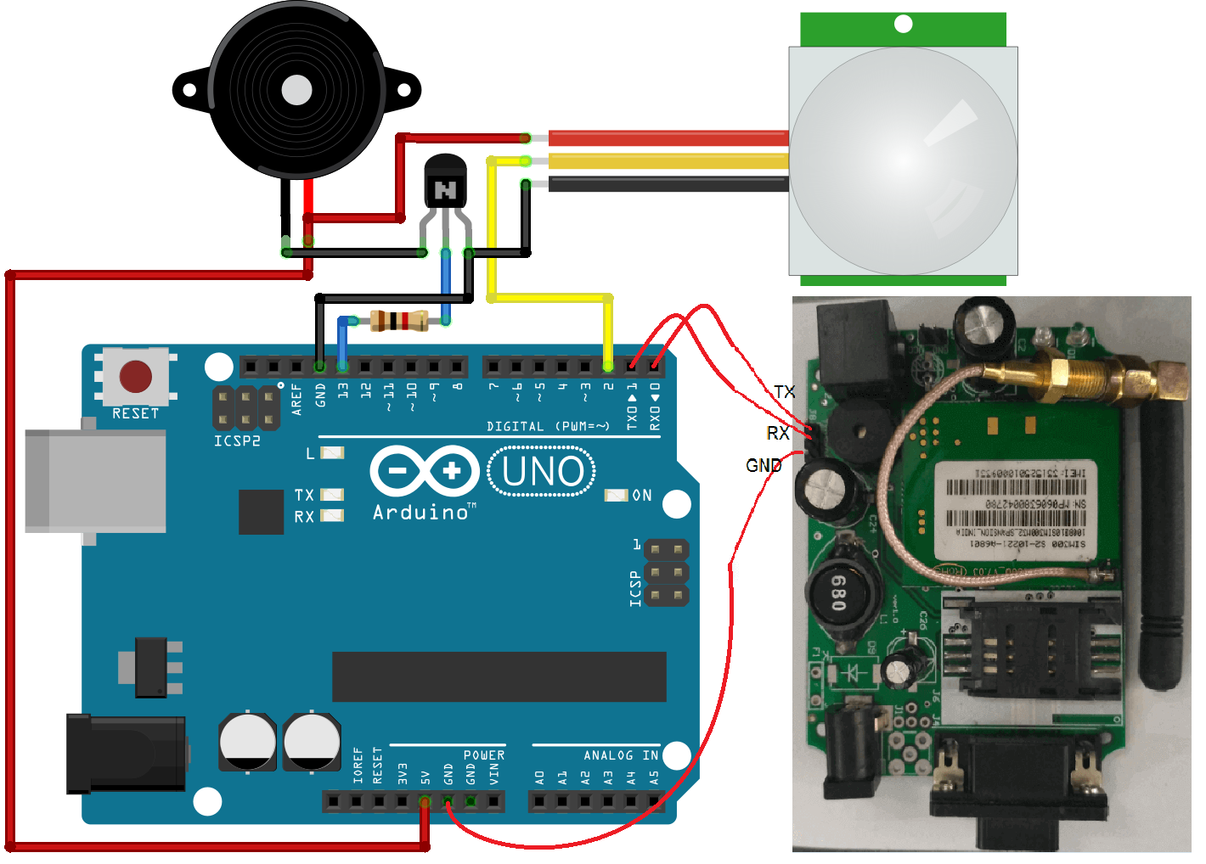
(1.) Robot + Remote Part – The farmer can use it very easily and if he wants, he can also use it through his phone. And our machine was fully automatic. This help us in dilling + Seeding , harvesting , Water Sprinkler, Irrigation, And Other. If you want it, you can control it from remote or if you want, from mobile app.
(2.) Land Part (Intruder detection) – The Smart Crop Protection System From Animals PIC, is designed to provide protection to crops against an intrusive animals. Keeping in mind the losses occur due to animals ravaging the crops, this project could be a real lifesaver for the farmers. This a microcontroller based motion sensing device, which will trigger an alarm to frighten the intruder and send out a SMS to notify the user, as it detects a motion. The material have ability to generate electricity after given heat or cold, thus giving the sensor the ability to detect levels of infrared radiation. By utilizing the ability of detecting infrared radiation, the System detects the presence.

Slide 9
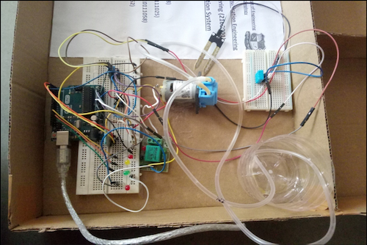
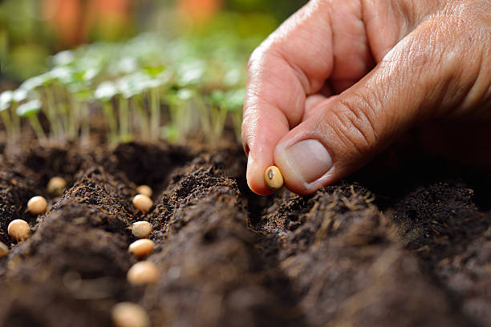
(3.) IOT Base Smart Irrigation System– This system is an attempt towards the smart irrigation system concept. An electronic device is responsible for sensing the temperature and moisture conditions. Along with it, Wi-Fi functionality is added to the hardware device. The sensed environmental conditions are taken and sent to the Server. The sensor nodes are then deployed in the irrigation field for sensing moisture value of soil and this sensed data is sent to the controller node.
And the Functions Are -
1. Seeding: The seeding operation takes place with help of dc motor which is controlled through Arduino Control the process of system. The seeding mechanism has a conveyor belt which has grooves on certain intervals which fits one seed There is a tank with the respective seeds and has an opening which is programmed in such a way that it will allow only certain amount of seeds required for a particular crop.

